Slide 1
Environmental Monitoring: Protecting Our Planet
Subtitle: An overview of the importance and methods of environmental monitoring
Team Members
P.Gomathy
R.Gurunathan
E.Ashokbharathi
J.Kalanithi
S.Priyadharshini
S.Sugumaran

Slide 2
Introduction
Content:
Briefly introduce the topic of environmental monitoring.
Mention the significance of monitoring our environment.
State the objectives of the presentation.

Slide 3
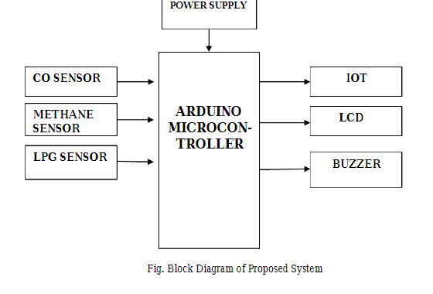
BLOCK DIAGRAM

